Slide 1
The Global Indicator Framework
DA 10 Opening Workshops

Slide 2
Outline
Indicator Framework Mandate
Inter-agency and Expert Group on Sustainable Development Goal Indicators (IAEG-SDGs)
The Global Indicator Framework
Follow-up and reviews of the global indicators
Relationship between global, regional and national indicators
Data custodian agencies
IAEG-SDG work programme for 2017
IAEG-SDG reference materials

Slide 3
Indicator Framework Mandate
Agenda 2030 (A/Res/70/1) mandate for the global indicator framework:
Para 75. The Goals and targets will be followed up and reviewed using a set of global indicators. These will be complemented by indicators at the regional and national levels which will be developed by Member States, … The global indicator framework, to be developed by the Inter-Agency and Expert Group on Sustainable Development Goal Indicators, will be agreed by the Statistical Commission …

Slide 4
Inter-agency and Expert Group on Sustainable Development Goal Indicators (IAEG-SDGs)
The IAEG-SDGs was tasked with:
Developing the global indicator framework
Providing technical support for implementation
Regularly reviewing methodological developments, the indicators and their metadata
Regularly reviewing capacity-building activities
Composition of the IAEG-SDGs:
27 representatives of national statistical offices (plus the Chair of the Statistical Commission as ex-officio member) and include, as observers, other member states, representatives of regional commissions, and regional and international agencies

Slide 5
The Global Indicator Framework
The Global Indicator Framework for the SDGs was developed by the IAEG-SDGs in an open and transparent manner involving all stakeholders
Between June 2015 and February 2016, the Expert Group developed the initial set of global indicators, and then submitted them to UNSC 47 in March 2016.
The UNSC, in its decision 47/101, agreed, as a practical starting point, with the proposed global indicator framework for the Goals and targets of the 2030 Agenda for Sustainable Development, subject to future technical refinement.
Notes:
Between June 2015 and February 2016, through various open consultations the Expert Group received thousands of comments by observers, including countries, international and regional agencies, civil society, academia and the private sector on the indicator framework.

Slide 6
The Global Indicator Framework
The Global Indicator Framework for the SDGs was then adopted by the UN Statistical Commission at its 48th session in March 2017
Agreed with the revised global indicator framework for the Goals and targets of the 2030 Agenda for Sustainable Development, including refinements on several indicators.
Draft resolution, including the global indicator framework, adopted by the Statistical Commission at UNSC 48th session will be proposed to ECOSOC and the GA for adoption, in line with existing mandates.
The global indicators will be yearly refined and comprehensively reviewed by the UNSC 51st session in 2020 and its 56th session in 2025.
Notes:
Global Indicator Framework included in the IAEG-SDG meeting report (Annex III) to the UNSC 48 available at the following website:
https://unstats.un.org/unsd/statcom/48th-session/documents/2017-2-IAEG-SDGs-E.pdf
Draft resolution available here: https://unstats.un.org/unsd/statcom/48th-session/documents/Resolution_on_Indicators_Clean_Version.pdf

Slide 7
The Global Indicator Framework
The agreed global indicator framework, including refinements, contains 232 unique indicators, addressing each and every one of the Goals and targets of the 2030 Agenda for Sustainable Development.
A tier system for the SDG indicators was developed for the implementation:
Tier I: indicator is conceptually clear, established methodology and standards are available and data are regularly produced by countries.
Tier II: indicator is conceptually clear, established methodology and standards are available but data are not regularly produced by countries.
Tier III: no established methodology or standards are available for the indicator or methodology/standards are being developed or tested for the indicator.

Slide 8
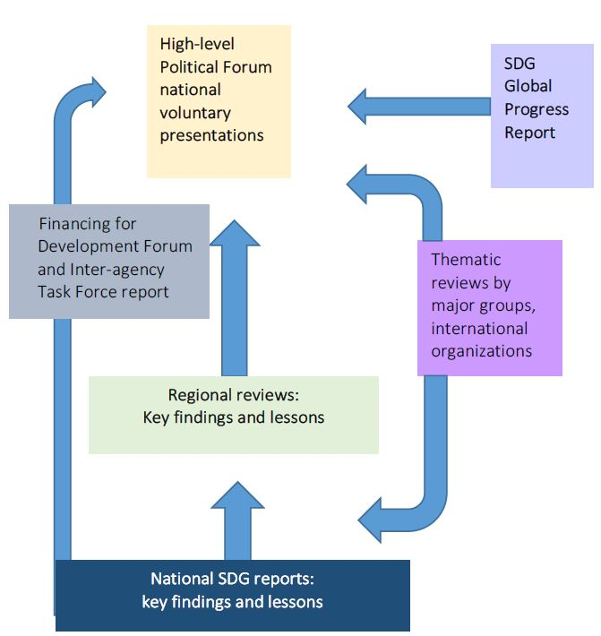
Follow-up and Reviews
Source: UNDG, Guidelines to Support Country Reporting on the Sustainable Development Goals

Slide 9
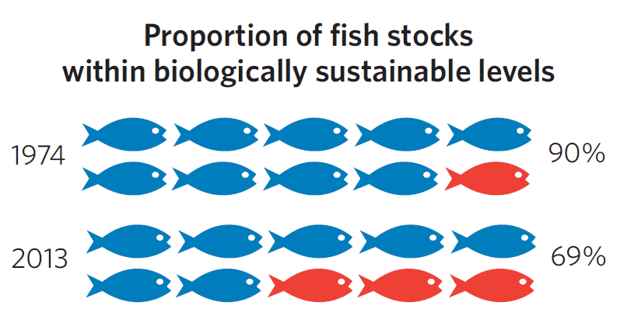
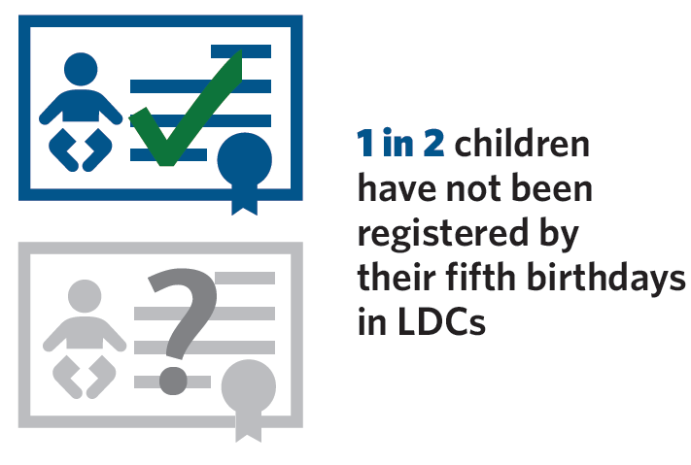
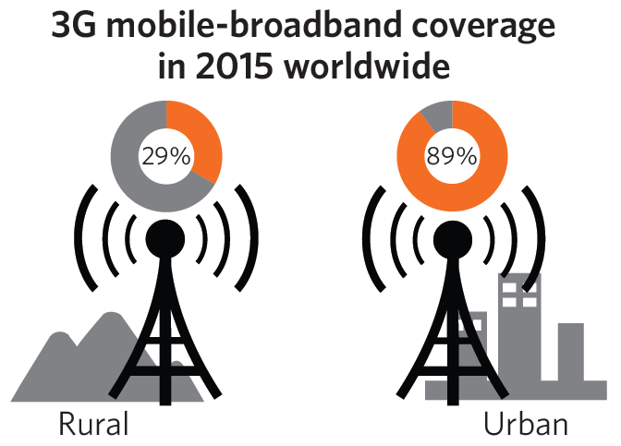
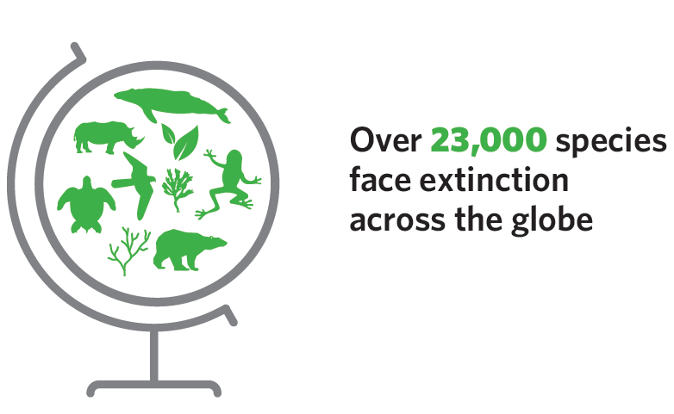
Global indicators are for
global review and follow-up
Overview Excerpts
Yearly Report
Photo: © UNICEF/Yarim Shamsan
Notes:
Indicators in the global indicator framework are for global follow-up and review

Slide 10
Global indicators are complemented by national and regional indicators
SDGs are integrated into national development plans/frameworks (“domestication” of SGDs)
Decisions on national indicators are driven by national priorities
National indicators are aligned with global indicators to the extent possible

Slide 11
Data Flow in SDG Reporting
Regional Organizations
CSOs
Data and Metadata
National Statistical System
International Agencies
Private Sector
NSO
Adjusted, estimated or modelled data
Academia
Global SDG Indicator Database (UNSD)
Country Data Lab (UNSD)

Slide 12
Data Custodian Agency
An agency is referred to as “custodian” when:
It has an existing mandate for the indicator in question and established data reporting mechanisms from countries.
It does not have an explicit mandate from its intergovernmental process but has a well established data reporting mechanism, recognized by Member States, and clearly identified counterpart in countries’ government agencies.
Responsibilities include:
Compiling internationally comparable data in the different statistical domains;
Supporting increased adoption and compliance with internationally agreed standards; and
Strengthening national statistical capacity.

Slide 13
Data Custodian Agency
Other responsibilities of a custodian agency include:
Communicating and coordinating with national statistical systems in a transparent manner, including on the validation of estimates and data adjustments when these are necessary;
Compiling the international data series, calculating global and regional aggregates and providing them, along with the metadata, to the Statistics Division;
Preparing the storyline for the annual global progress report; and
Coordinating on indicator development with national statistical systems, other international agencies and stakeholders.
Notes:
To the extent possible, there should be only one custodian agency per indicator (generally this is the agency to which countries report directly – main data provider)
In few exceptional cases, more than one agency work together in gathering and compiling the data (co-custodian)
For some of the indicators in Tier III, several agencies work together to develop the methodology (to be decided whether ultimately only one or two become data custodian as main data provider/s).

Slide 14
IAEG-SDG work programme for 2017
Establish procedures for the review of work plans for Tier III indicators and finalize a mechanism for moving indicators from one tier to another;
Start the process of reviewing possible additional indicators
Review the availability of data for Tier I and Tier II indicators and develop a plan for increasing the data coverage of Tier II indicators with the joint subgroup of the Expert Group and the High-level Group for Partnership, Coordination and Capacity-Building for Statistics for the 2030 Agenda for Sustainable Development;

Slide 15
IAEG-SDG work programme for 2017
(continued)
Develop further guidance on the issue of data disaggregation;
Continue the work of the three working groups, on statistical data and metadata exchange, geospatial information and interlinkages;
Hold two meetings, the first in March 28-31 2017 in Ottawa, Canada and the second in the fourth quarter of 2017 (dates to be determined), and continue to interact electronically and through teleconferences, as needed.

Slide 16
IAEG-SDG Reference Materials
Materials related to the work of the IAEG-SDGs can be found on the website of the group:
https://unstats.un.org/sdgs/iaeg-sdgs/
Documents on the website include:
Terms of reference of the group
List of member countries
Tier Classification of the Global Indicators
Work Plans for Tier III Indicators
Information on the three working groups of the IAEG-SDGs: SDMX, Geo-spatial information and interlinkages

Slide 17
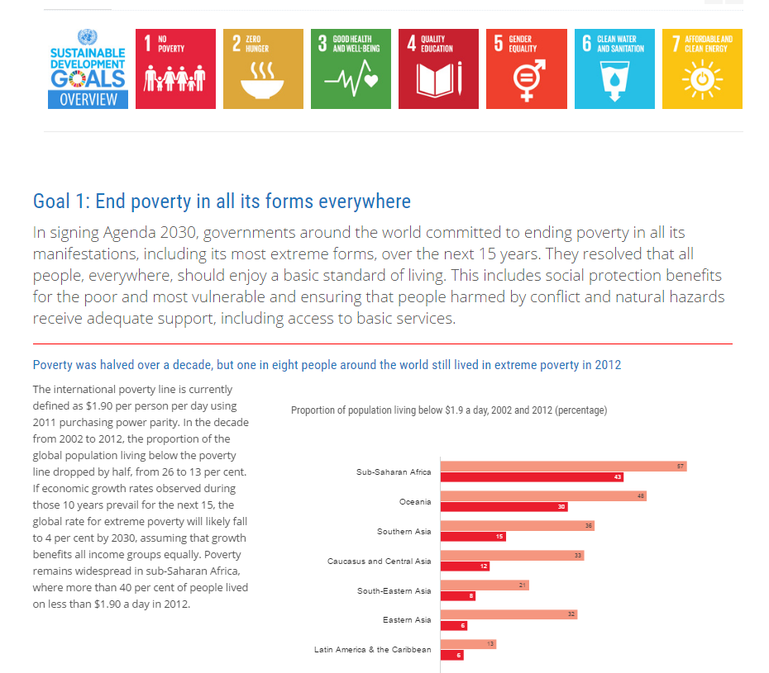
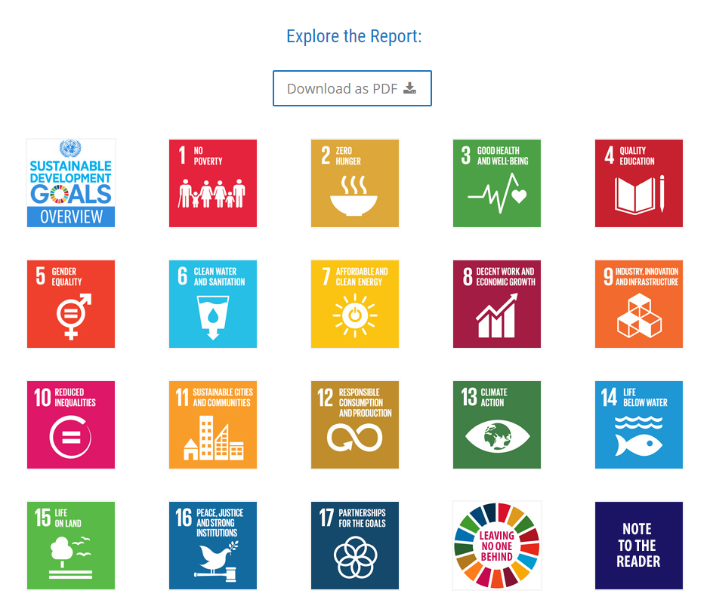
SDG Website: http://unstats.un.org/sdgs/
Explore the Report with interactive charts and graphs for every Goal
Charts and graphs link to data for direct download

Slide 18
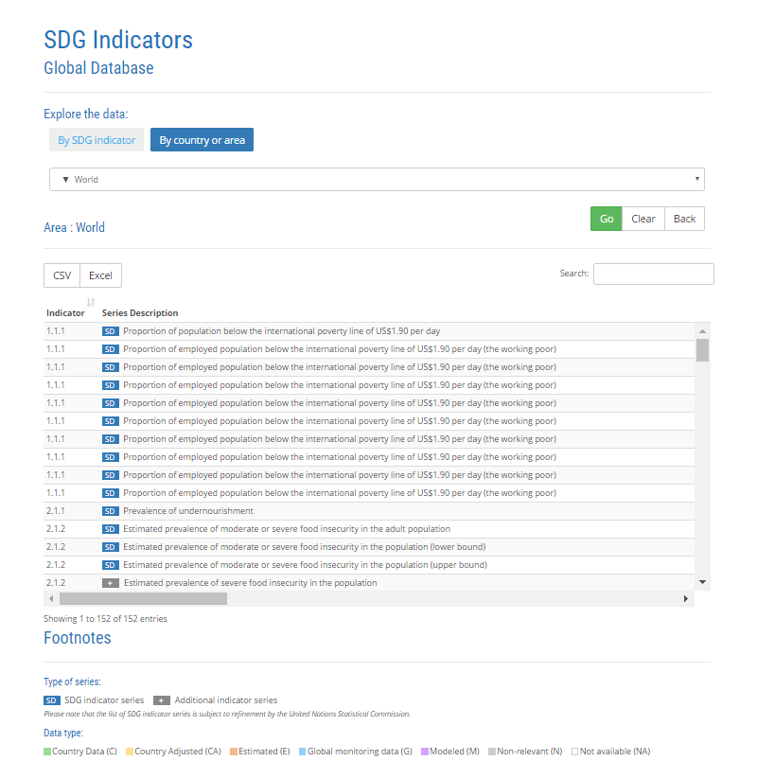
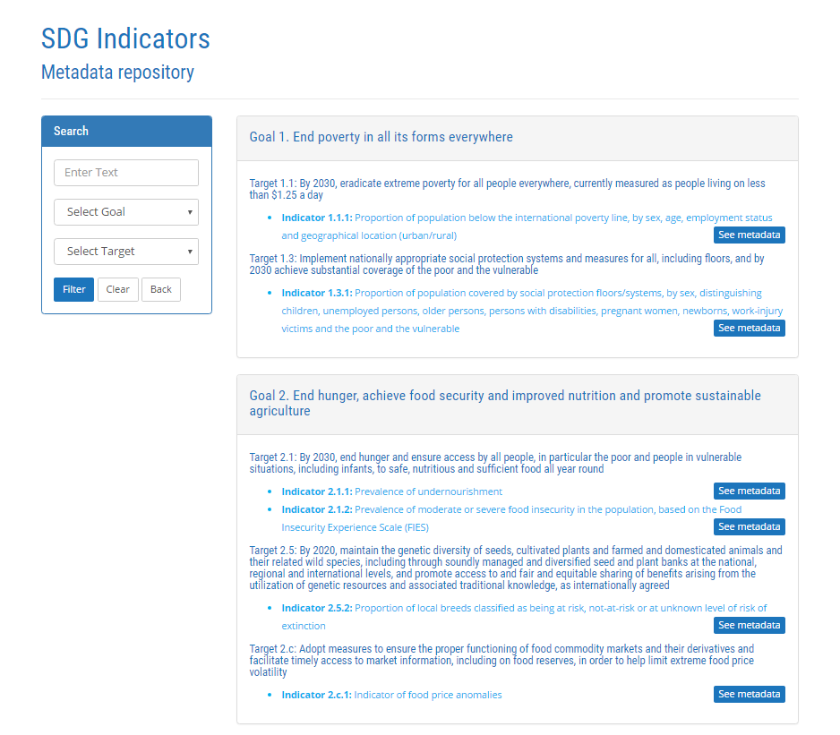
SDG Website: http://unstats.un.org/sdgs/
SDG Indicators Global Database with country-level data
SDG Indicator Metadata

Slide 19
Thank you
SDGs website:
https://unstats.un.org/sdgs/

